Slide 1
EDUCATION
Show them new worlds without leaving the classroom.

Slide 2
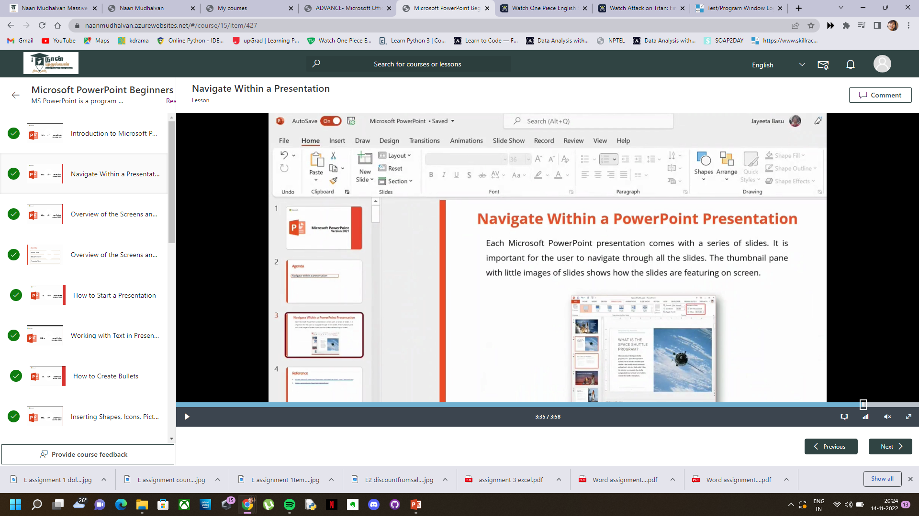
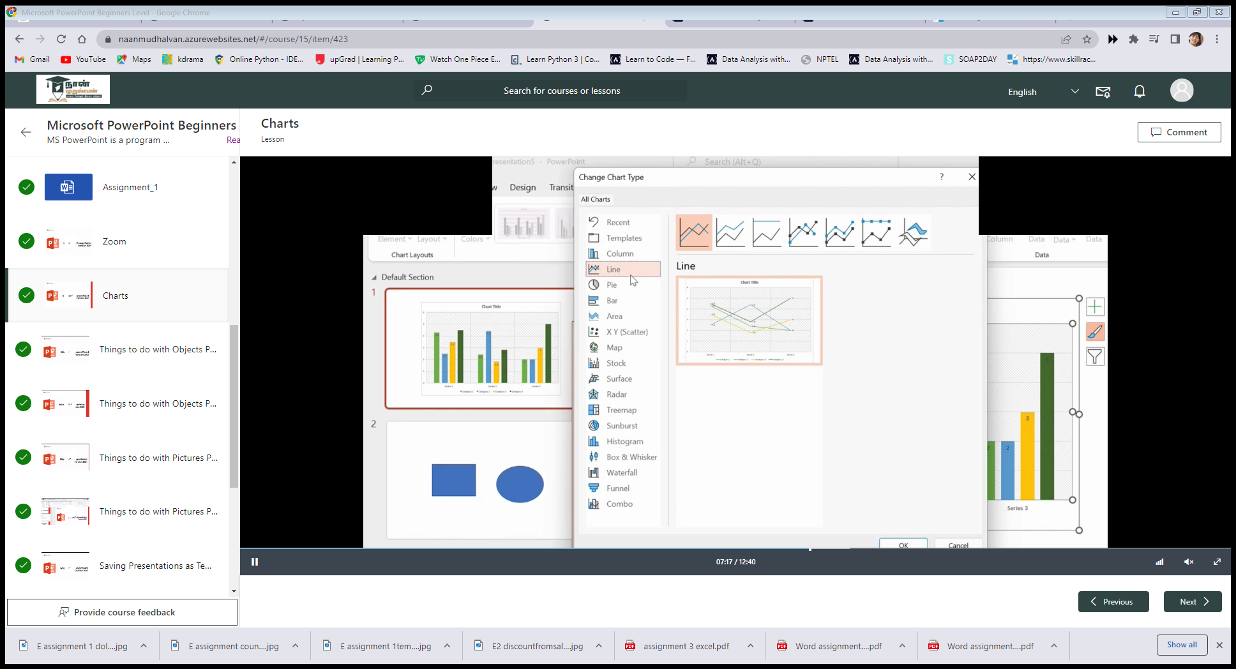
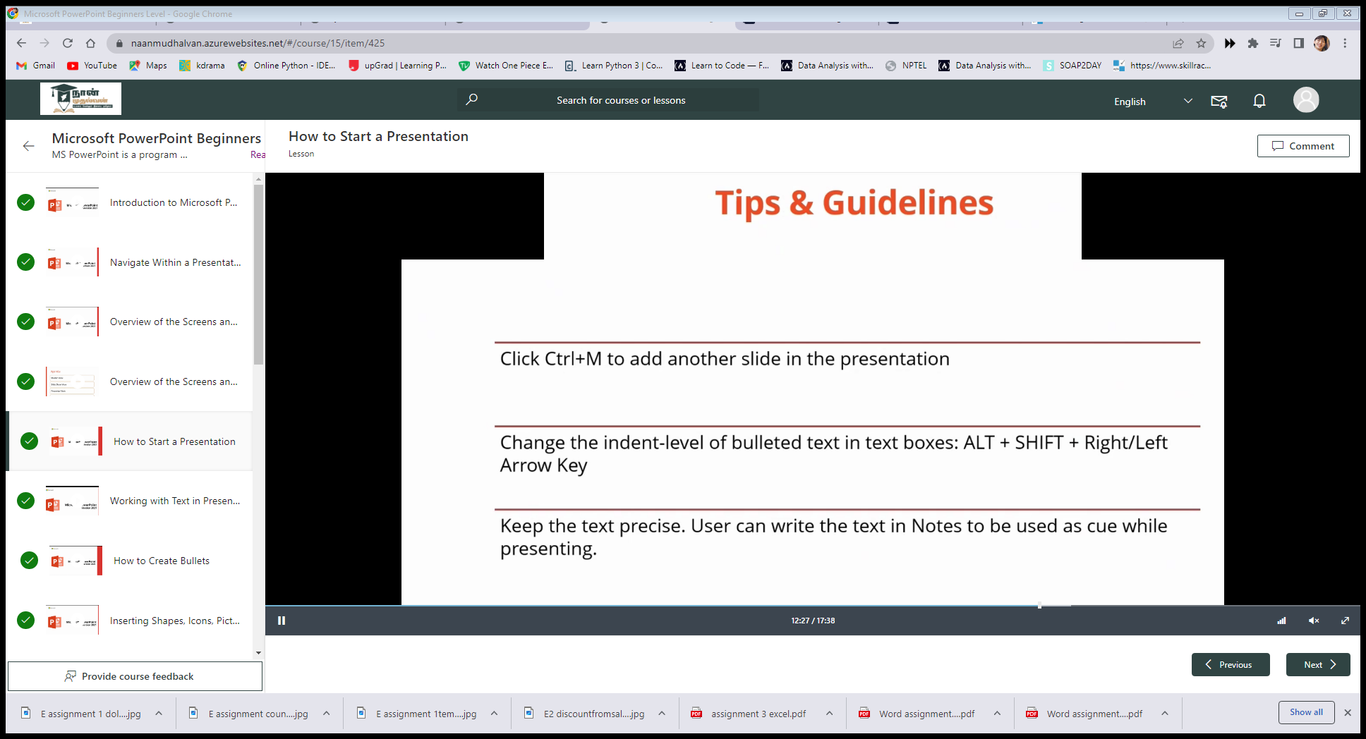
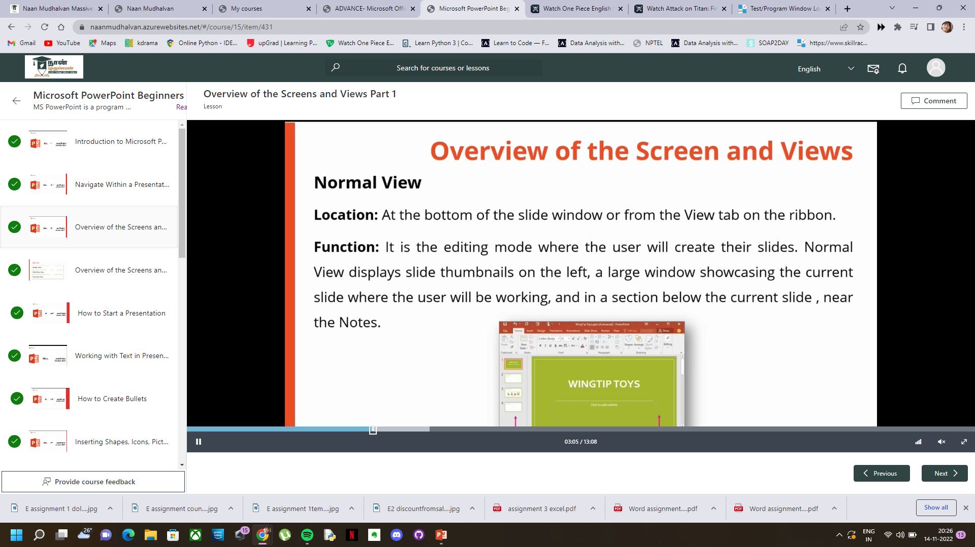
What we have learnt

Slide 3

Microsoft PowerPoint
AGENDA
Importance of powerpoint
Creating a new powerpoint
Overview of screen and views
Tips and guidelines
Conclusion

Slide 4

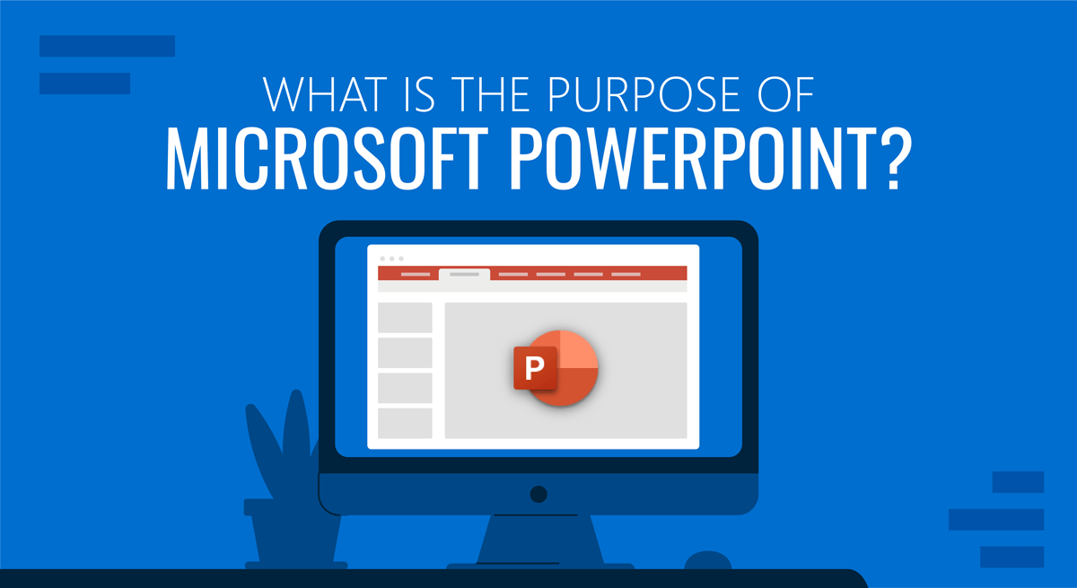
Importance of powerpoint
l
Visual impact
Easy to use
Templates
Secures presentation
Resourse pool

Slide 5
CREATING A NEW PRESENTATION
FROM SCRATCH
USER CAN CREATE THEIR OWN DESIGNS ,ADD GRAPHICS ADD VISUALIZATIONS etc…
FROM TEMPLATE
THE TEMPLATE ARE PRELOADED ,HELPS THE USER IN DESIGNING REPRESENTATION EASILY.

Slide 6
OVERVIEW OF SCREEN AND VIEWS
Slide sorter view
Notes page view
Outline view
Master view
Slide show view
Presenter view

Slide 7
SAVING PRESENTATION AS TEMPLATES
USER CAN CREATE PRESENTATIONS AND SAVE IT AS TO BE RE USED. TO C REATE THE TEMPLATE,THE USER NEEDS TO MODIFY THE SLIDE ANS A SET OF SLIDE LAYOUTS
TO SAVE THE PRESENTATIONS AS POWERPOINT TEMPLATE – USER NEEDS TO SAVE THE FILE USING (.potx)

Slide 8

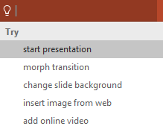

More questions about PowerPoint?
Select the Tell Me button
Select The Arrows When In Slide Show Mode
and type what you want to know.
https://www.linkedin.com/learning/paths/getting-started-with-microsoft-powerpoint
https://learn.microsoft.com/en-us/training/educator-center/product-guides/powerpoint

